Slide 1

Topic for the class: Number Systems Unit 1 : Number Systems Date & Time :
M.N.V.L.M.KRISHNA
Assistant Professor
Department of Electrical Electronics and Communication Engineering
GITAM Institute of Technology (GIT)
Visakhapatnam – 530045
Email: mmunagal@gitam.edu

Slide 2

Course objectives
Facilitate the student to represent numbers in different number systems and convert numbers from one number system to another.
Introduce logic gates and theorems and properties of Boolean algebra.
Familiarize the student with techniques for minimization expression and establish its necessity.
Demonstrate the design of combinational and sequential logic circuits.
Video Box Position

Slide 3
Learning Outcomes
After completion of this unit, the student will be able to
Explain different number systems
Solve the number system conversion problems.
Apply arithmetic operations on signed and unsigned binary numbers.
Explain basic error detection and correction methods.
Video Box Position

Slide 4
Introduction to the Course
Digital logic circuits are the basic building blocks of modern computers.
To understand the working of computers, one needs to know how numbers are represented and processed using digital logic circuits.
This course first teaches number representation in computers and Boolean algebra.
After covering minimization of expressions and basic logic gates, the design of combinational and sequential circuits that perform a specific function are discussed.
The aim of the course is to provide the student with an understanding of how data is represented and processed at the hardware level.
This course acts as a foundation for a course on Computer Architecture and Organization
Video Box Position

Slide 5
Digital Logic circuits
Digital electronics or digital logic circuits are electronics that handle digital signals – discrete bands of analog levels – rather than by continuous ranges (as used in analogue electronics.
Digital electronic circuits are usually made from large assemblies of logic gates, simple electronic representations of Boolean logic functions.
Video Box Position

Slide 6
Advantages of digital circuits
An advantage of digital circuits when compared to analog circuits is that signals represented digitally can be transmitted without degradation due to noise.
In a digital system, a more precise representation of a signal can be obtained by using more binary digits to represent it.
Computer-controlled digital systems can be controlled by software, allowing new functions to be added without changing hardware.
Information storage can be easier in digital systems than in analog ones. The noise- immunity of digital systems permits data to be stored and retrieved without degradation
Video Box Position

Slide 7
Number Systems
A numbering system is a way of representing numbers.
In Digital electronics number system is used for representing the information.
. The most commonly used numbering system in real life is Decimal number system. Other number systems are Binary, Octal, Hexadecimal number system.
Each number system is uniquely identified by its base value or radix.
Radix or base is the count of number of digits in each number system. Radix or base is the general idea behind positional numbering system.
Video Box Position

Slide 8
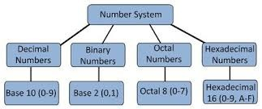
Various Number Systems
There are basic four types of number systems.
Video Box Position

Slide 9
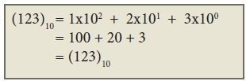
Decimal Number System
It consists of 0,1,2,3,4,5,6,7,8,9(10 digits).
It is the oldest and most popular number system used in our day to day life.
In the positional number system, each decimal digit is weighted relative to its position in the number.
This means that each digit in the number is multiplied by 10 raised to a power corresponding to that digit’s position.
Example:
Video Box Position

Slide 10
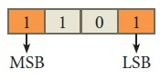
Binary Number System
There are only two digits in the Binary system, namely, 0 and 1.
The numbers in the binary system are represented to the base 2 and the positional multipliers are the powers of 2.
The left most bit in the binary number is called as the Most Significant Bit (MSB) and it has the largest positional weight.
The right most bit is the Least Significant Bit (LSB) and has the smallest positional weight.
Example :
Video Box Position

Slide 11
Octal and Hexa decimal Number System
Octal number system uses digits 0,1,2,3,4,5,6 and 7 (8 digits). Each octal digit has its own positional value or weight as a power of 8.
A hexadecimal number is represented using base 16. Hexadecimal or Hex numbers are used as a shorthand form of binary sequence.
This system is used to represent data in a more compact manner. Since 16 symbols are used, 0 to F, the notation is called hexadecimal.
The first 10 symbols are the same as in the decimal system, 0 to 9 and the remaining 6 symbols are taken from the first 6 letters of the alphabet sequence, A to F, where A represents 10, B is 11, C is 12, D is 13, E is 14 and F is 15.
Video Box Position

Slide 12
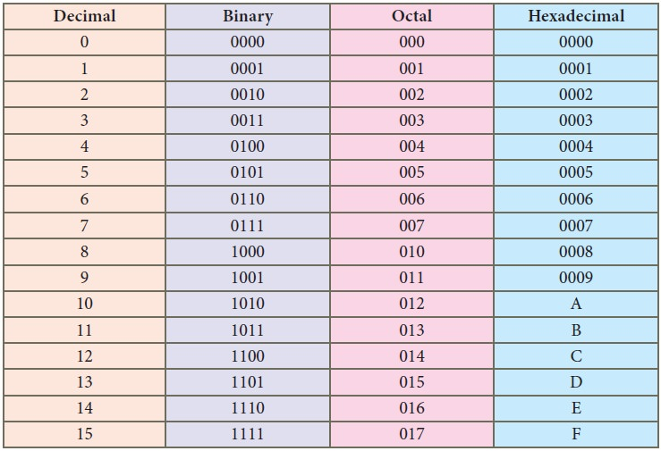
Representation of a Number in Various Number Systems
Video Box Position

Slide 13
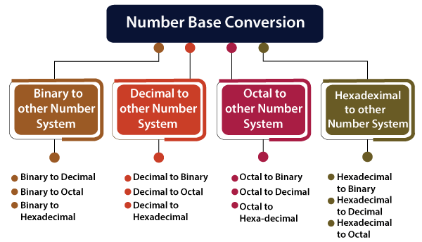
Number system Conversion
Video Box Position

Slide 14
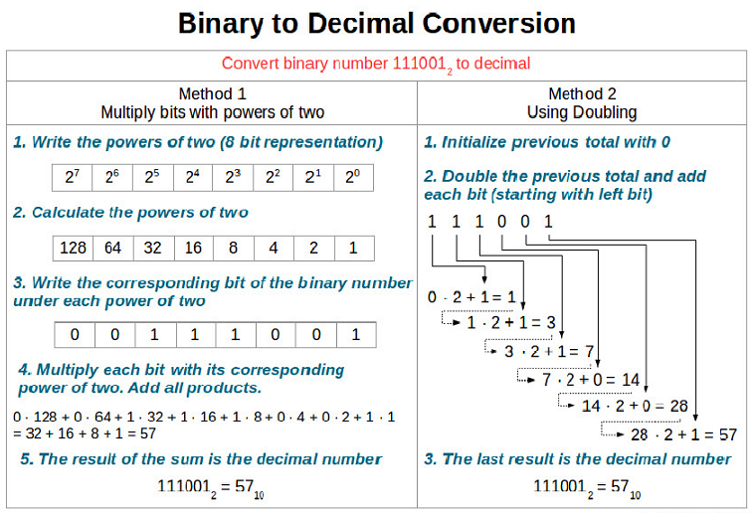
Video Box Position

Slide 15
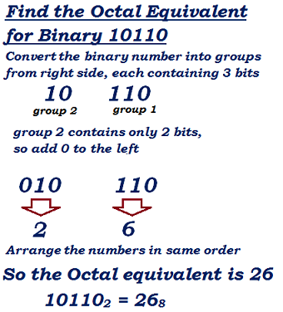
Binary to Octal Conversion
Video Box Position

Slide 16
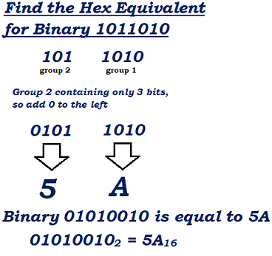
Binary to Hexa Decimal Conversion
Video Box Position

Slide 17
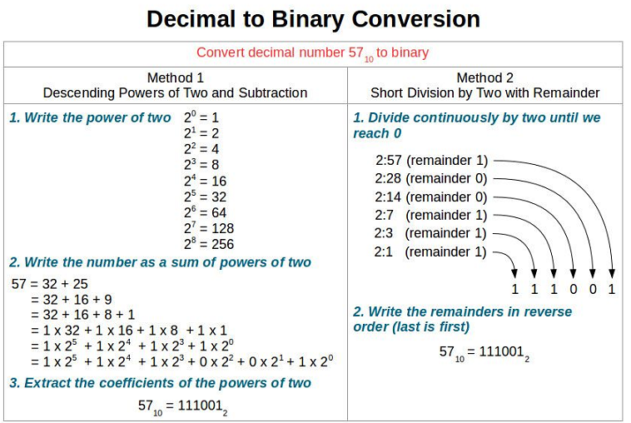
Video Box Position

Slide 18
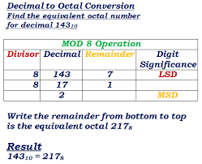
Video Box Position

Slide 19
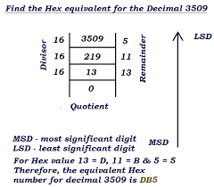
Decimal to Hexa Decimal Conversion
Video Box Position

Slide 20
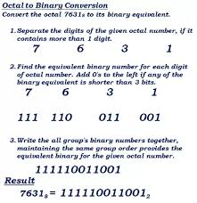
Octal to Binary Conversion
Video Box Position

Slide 21
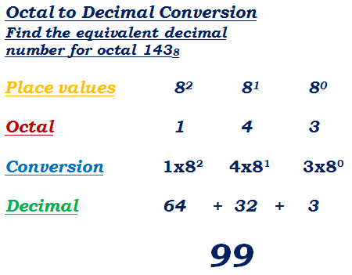
Video Box Position

Slide 22
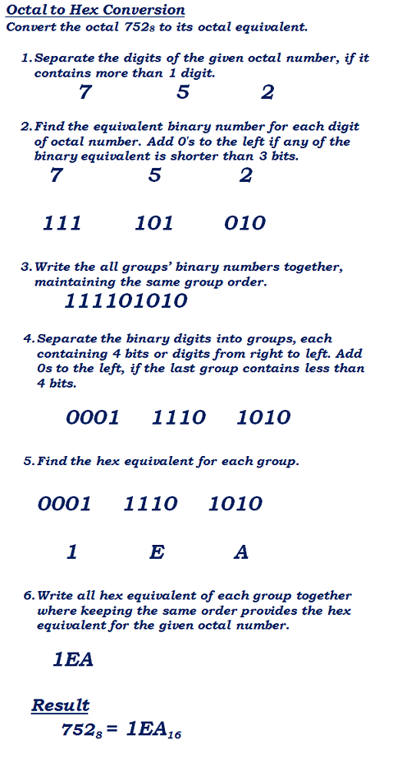
Video Box Position

Slide 23
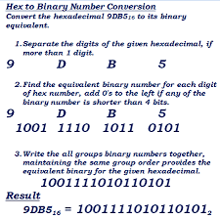
Video Box Position

Slide 24
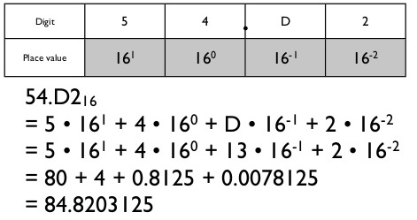
Hexa Decimal to Decimal Conversion
Video Box Position

Slide 25
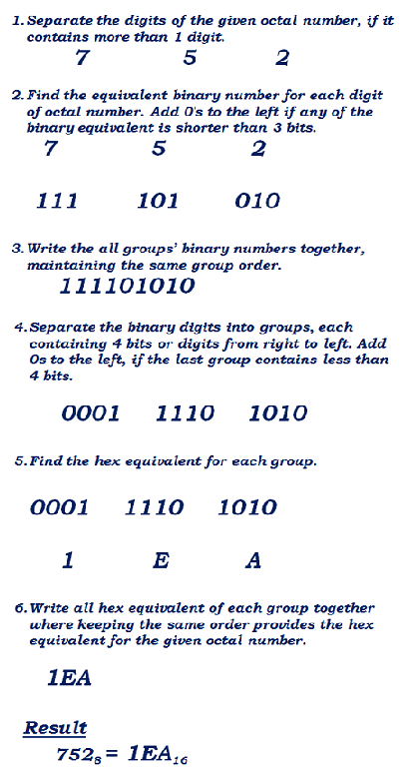
Hexa Decimal to Octal Conversion
Video Box Position

Slide 26
Flash Quiz
1. Convert the decimal number 3315.3 to hexadecimal
notation. What about the hexadecimal equivalent
of the decimal number 3315.3
2. Convert your Present Age in Decimal number system into
Binary, Octal and Hexa Decimal Number System.
Video Box Position

Slide 27
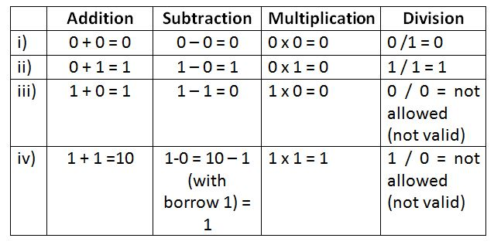
Binary Arithmetic Rules
Video Box Position

Slide 28
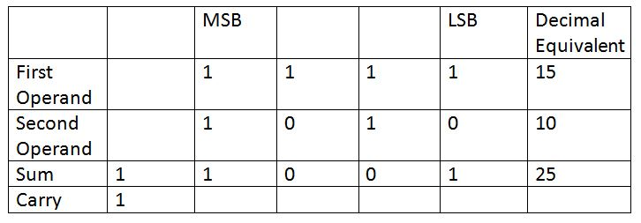
Binary Addition
Video Box Position

Slide 29
Binary Addition
Video Box Position

Slide 30
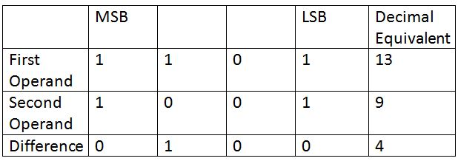
Binary Subtraction
Video Box Position

Slide 31
SIGNED BINARY NUMBERS
Positive integers including zero can be represented as unsigned numbers.
However, to represent negative integers, we need a notation for negative values.
Because of hardware limitations, computers must represent everything with
binary digits, commonly referred to as bits.
It is important to realize that both signed and unsigned binary numbers consist
of a string of bits when represented in a computer.
For example,
The string of bits 01001 can be considered as 9 (unsigned binary) or a +9 (signed binary) because the leftmost bit is O.
The string of bits 11001 represent the binary equivalent of 25 when considered as an unsigned number or as – 9.
when considered as a signed number because of the I in the leftmost position, which designates negative, and the other four bits, which represent binary 9.
Usually, there is no confusion in identifying the bits if the type of representation for the number is known in advance.
Video Box Position

Slide 32
SIGNED BINARY NUMBERS
As an example, consider the number 9 represented in binary with eight bits.
+9 is represented with a sign bit of 0 in the leftmost position followed by the
binary equivalent of 9 to give 00001001.
Note that all eight bits must have a value and, therefore, O's are
inserted following the sign bit up to the first I.
Although there is only one way to represent +9, there are three
different ways to represent - 9 with eight bits:
In signed-magnitude representation: 10001001
In signed-I's-complement representation:11110110
In signed-Z's-complement representation:11110111
Video Box Position

Slide 33
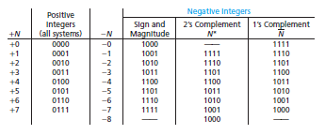
Negative number representation
Video Box Position

Slide 34
Complements
Complements are used in digital computers to simplify the subtraction operation and for logical manipulation
They are two types of complements
1) Diminished radix complement
(r^{N} -1)- N {r is the base of num system}
2) Radix Complement (r^{N} -1)-N+1

Slide 35
(r-1)’s complement
If the base = 10
The 9's complement of 546700 is
999999 -546700 = 453299.
If the base = 2
The 1's complemcnt of 1011000 is 0100111.

Slide 36
r’scomplement
The 10's complement of 012398 is 987602
The 2's complement of 1101100 is 0010100

Slide 37
Subtraction using complements
Discard end carry for r‟scomplement
Using 10's complement subtract 72532 -3250.
M = 72532
10's complement of N = + 96750
Sum = 169282
Discard end carry for 10‟s complement
Answer = 69282

Slide 38
Subtraction using (r-1)’s complement
X -Y = 1010100 -1000011
X = 1010100
1's comp of Y =+ 0111100
Sum = 1 0010000
Add End-around carry = + 1
X -Y = 0010001

Slide 39
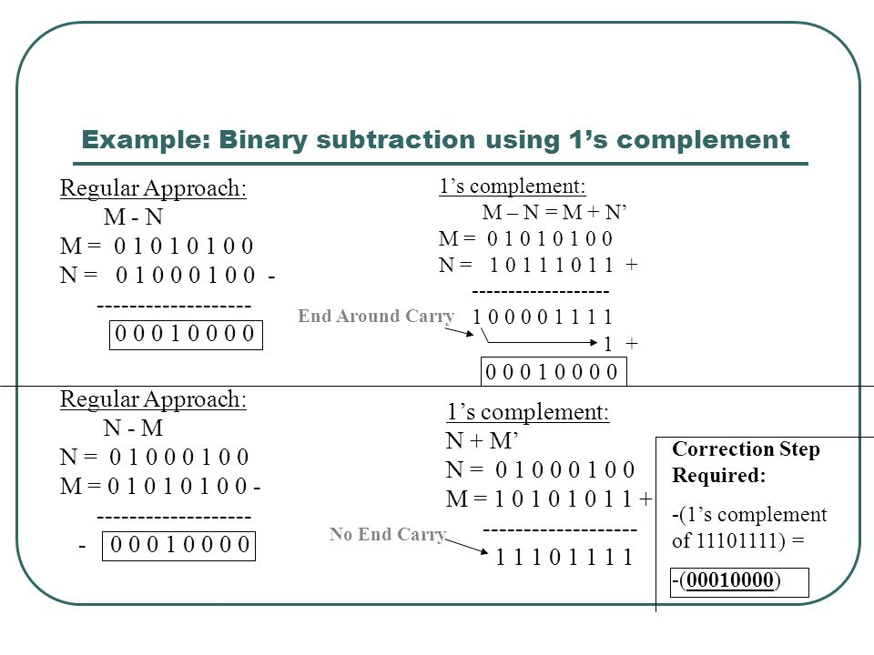
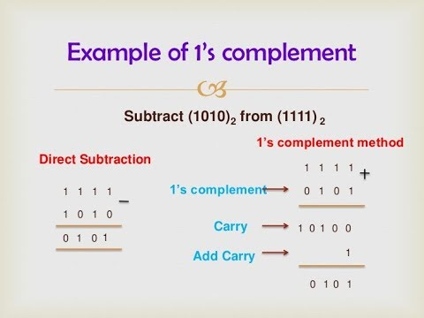
Video Box Position

Slide 40
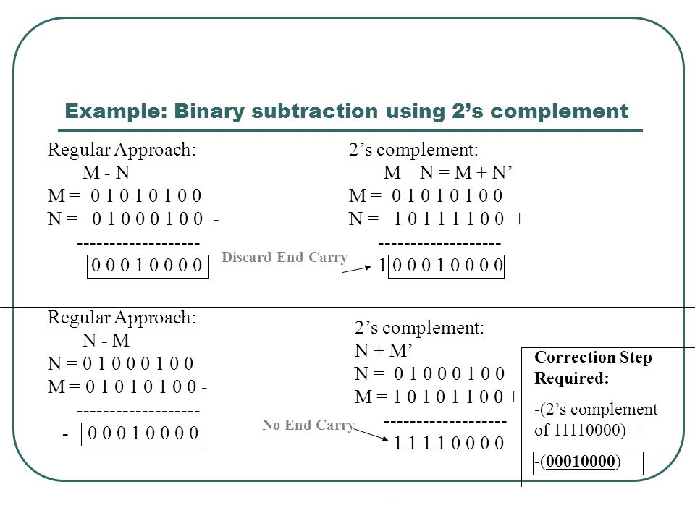
Video Box Position

Slide 41
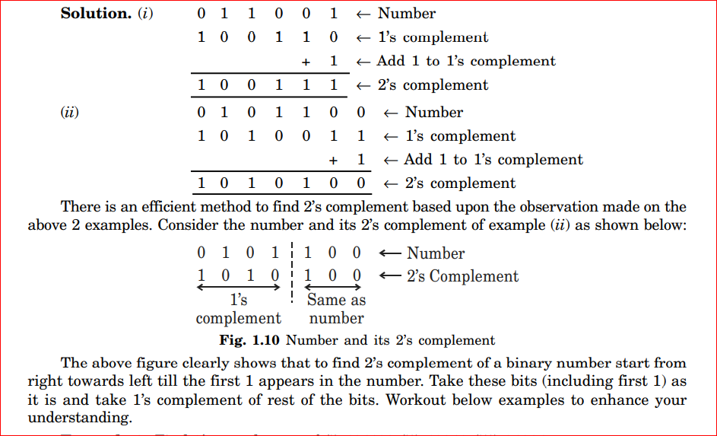
Keypoint

Slide 42
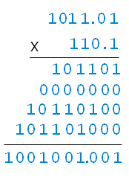
Binary Multiplication
Video Box Position

Slide 43
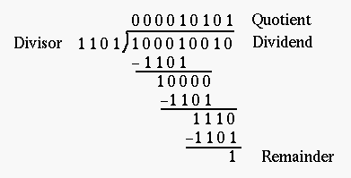
Binary Division
Set quotient to 0
Align leftmost digits in dividend and divisor
Repeat
If that portion of the dividend above the divisor is greater than or equal to the divisor
Then subtract divisor from that portion of the dividend and
Concatentate 1 to the right hand end of the quotient
Else concatentate 0 to the right hand end of the quotient
Shift the divisor one place right
Until dividend is less than the divisor
quotient is correct, dividend is remainder
STOP
Video Box Position

Slide 44
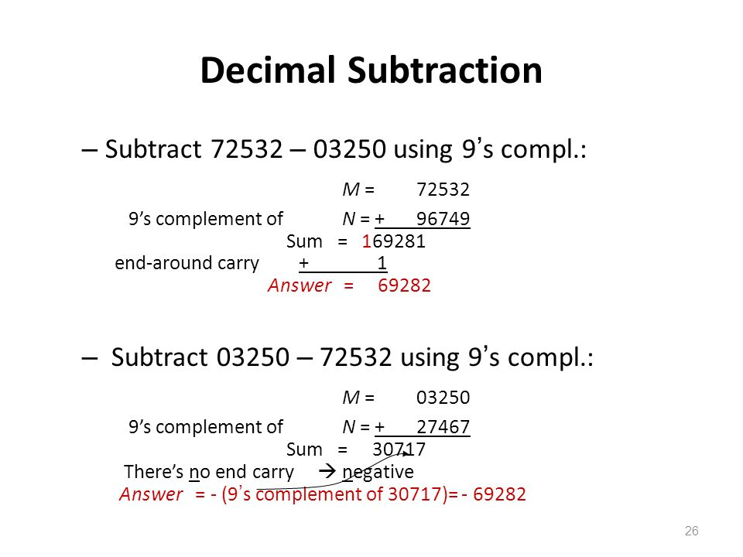
Decimal Subtraction by 9’s Complement method.
Video Box Position

Slide 45
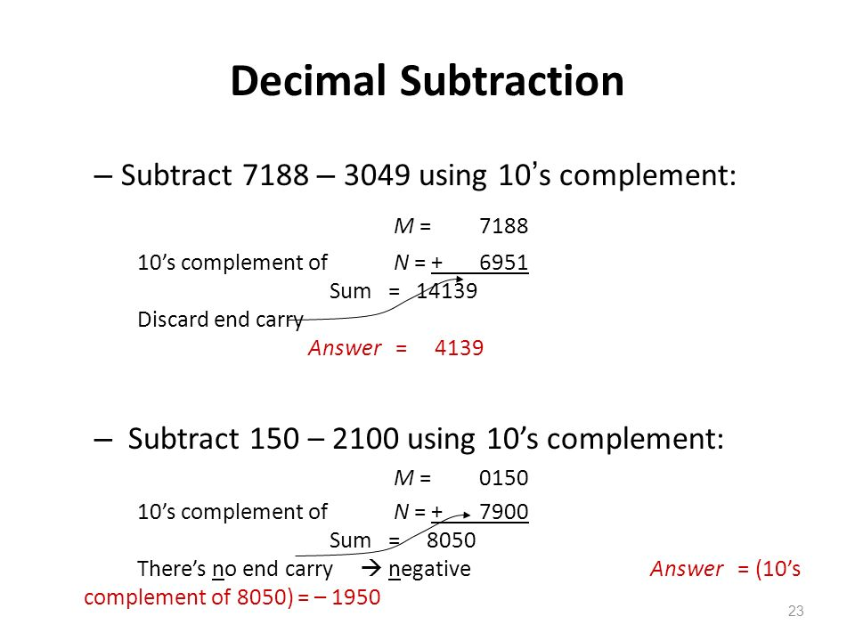
Decimal Subtraction by 10’s Complement method.
Video Box Position

Slide 46
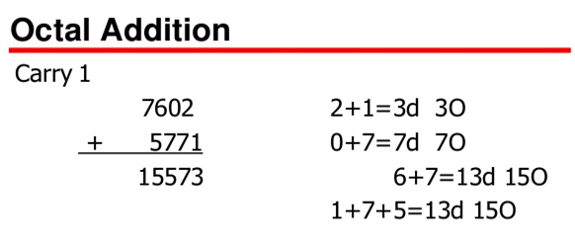
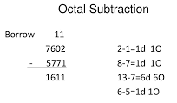
Octal Addition and Subtraction
Video Box Position

Slide 47
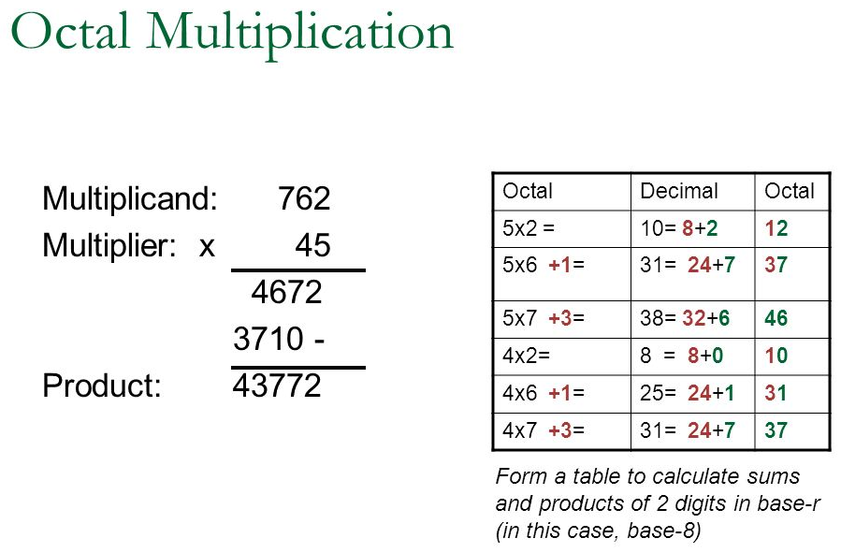
Video Box Position

Slide 48
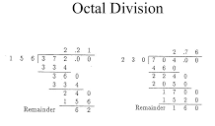
Video Box Position

Slide 49
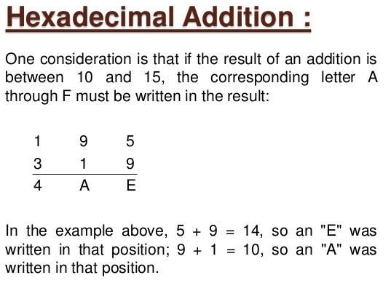
Video Box Position

Slide 50
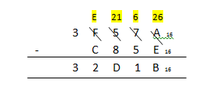
Hexa Decimal Subtraction
Video Box Position

Slide 51
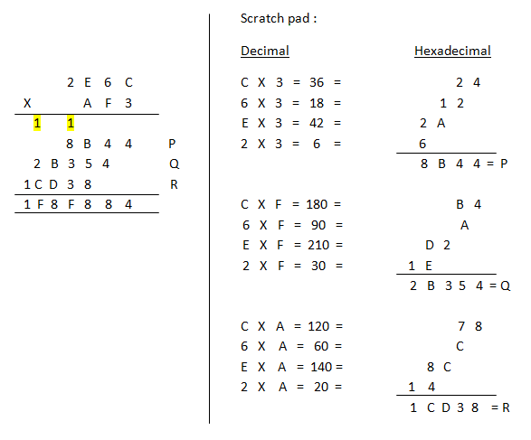
Hexa decimal Multiplication
Video Box Position

Slide 52
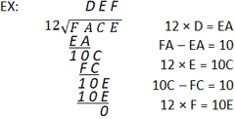
Hexa Decimal Division
Video Box Position

Slide 53
Recap – Summary – What you have learnt
Exposed to Various Number Systems
Conversion of one number into another number
a) Binary number into decimal, octal and Hexa decimal numbers
b) Decimal Number into binary, octal and hexadecimal numbers
c) Octal number into binary, decimal and hexadecimal numbers
d) Hexa decimal number into binary, decimal and octal numbers
Binary Arithmetic , octal and hexa decimal Arithmetic
Video Box Position

Slide 54
Session Quiz
1. The fraction (0.68)10 is equal to [ ]
a) (0.010101)2 b) (0.101)2 c) (0.10101)2 d) (0.10111)2
2. The Hexadecimal number A0 has the decimal value [ ]
a)80 b) 256 c) 100 d) 160
3. Given two numbers A & B in sign magnitude representation in an eight bit format A=00011110 & B=10011100, A XOR B gives [ ]
a)10000010 b) 00011111 c) 10011101 d) 11100001
4. The value of binary 1111 is [ ]
a) 23-1 b) 24-1 c) 24 d) none of these
5. The minimum number of bits required to represent negative numbers in the range of -1 to -11 using 2’s complement arithmetic is [ ]
(a) 2 (b) 3 (c) 4 (d) 5
Video Box Position

Slide 55
Binary Codes
Computers and other digital circuits process data in binary format. Various binary codes are used to represent data which may be numeric, alphabetic or special characters. Codes are also used for error detection and error correction in digital systems
There are several different types of Binary codes are used in digital system. All these digital codes may be classified into different categories as follows.
1. Weighted Codes. In weighted codes each binary bit is assigned by a weight and values depend on the position of the binary bit. The BCD code has weighted of 8, 4, 2 and 1. The bit assignment 0110, for example, is interpreted by the weights to represent decimal 6 because 8 × 0 + 4 × 1 + 2 × 1 + 1 × 0 = 6. Weights codes are of two types: (a) Binary – 8421 (b) BCD
2. Non-Weighted Codes. In this category of digital code, no specific weights are assigned to the bit position. Each digit position within the number is not assigned fixed value. Non-weighted codes are of two types. (a) Excess-3 (Ex-3) (b) Gray Code
Video Box Position

Slide 56
3. Reflective Codes
A code is said to be a reflective code when the code for 9 is the complement of 0, the code for 8 is complement for 1, 7 for 2, 6 for 3 and 5 for 4. Reflective codes are of the following these types:
(a) 2421 (b) 5211 (c) Ex-3
For example reflective code Position weights 2 4 2 1 Code for 9 - 1 1 1 1 Code for 0 0 0 0 0 Number 9 is the complement of 0.
Video Box Position

Slide 57
4. Sequential Codes
In sequential codes, each succeeding code is one binary number greater than its preceding code.
In Ex-3 code each decimal digit is obtained by adding decimal 3 to the natural code of the digit. The sequential codes are: (a) 8421 (b) Excess-3 (Ex-3)
For example the Ex-3 code of binary number 0010 (decimal code 2) is obtained by adding decimal 3 to the binary code. We add 3 to the decimal code 2 we get 5. The binary value of 5 is 0101. Thus the Ex-3 code of the binary number 0010 is 0101.
Video Box Position

Slide 58
5. Alphanumeric Codes. The various types of alphanumeric codes are:
(a) ASCII (American Standard Codes for Information Interchange)
(b) EBCDIC (Extended Binary Coded Decimal Interchanged Code)
(c) Hollerith
6. Error Detecting and Correcting Codes. The various types of error detecting and correcting codes are:
(a) Parity Code (b) Hamming Code
Video Box Position

Slide 59
BCD Code or 8421 Code
The full form of BCD is ‘Binary-Coded Decimal.’ Since this is a coding scheme relating decimal and binary numbers, four bits are required to code each decimal number.
For example, (35)10 is represented as 0011 0101 using BCD code, rather than (100011)2 .
Video Box Position

Slide 60
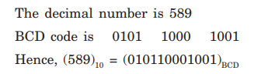
Q. Give the BCD equivalent for the decimal number 589.
Video Box Position

Slide 61
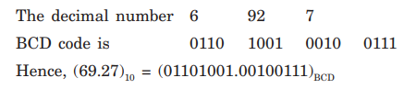
Give the BCD equivalent for the decimal number 69.27
Video Box Position

Slide 62
84-2-1 Code
It is also possible to assign negative weights to decimal code, as shown by the 84- 2-1 code.
In this case the bit combination 0101 is interpreted as the decimal digit 3, as obtained from 0 × 8 + 1 × 4 + 0 × (–2) + 1 × (–1) = 3.
This is a self-complementary code,
Video Box Position

Slide 63
2421 Code
Another weighted code is 2421 code. The weights assigned to the four digits are 2, 4, 2, and 1.
The 2421 code is the same as that in BCD from 0 to 4; however, it varies from 5 to 9.
For example, in this case the bit combination 0100 represents decimal 4; whereas the bit combination 1101 is interpreted as the decimal 7, as obtained from 2 × 1 + 1 × 4 + 0 × 2 + 1 × 1 = 7.
This is also a self-complementary code.
Video Box Position

Slide 64
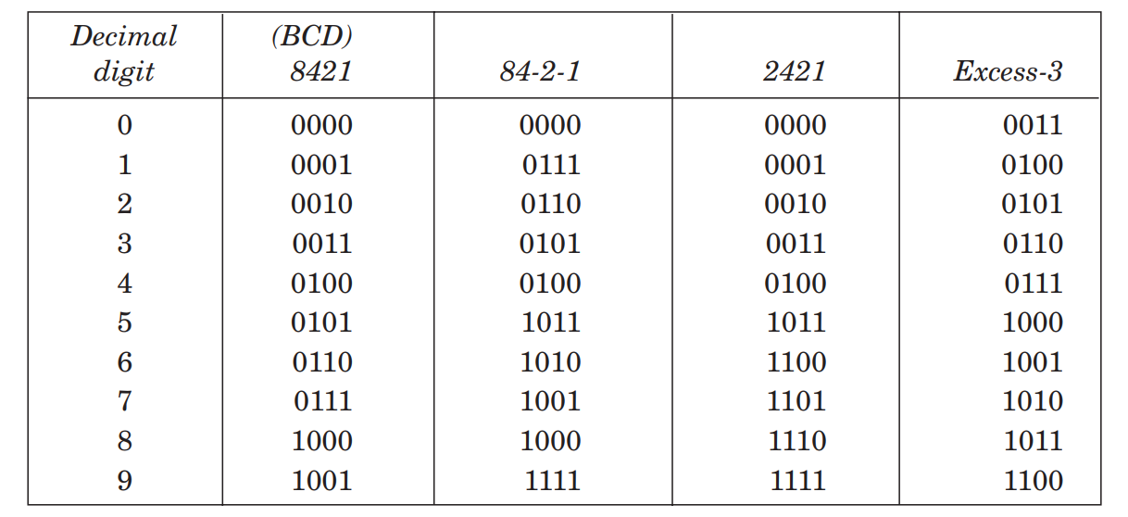
Binary codes for decimal digits
Video Box Position

Slide 65
BCD Addition
Video Box Position

Slide 66
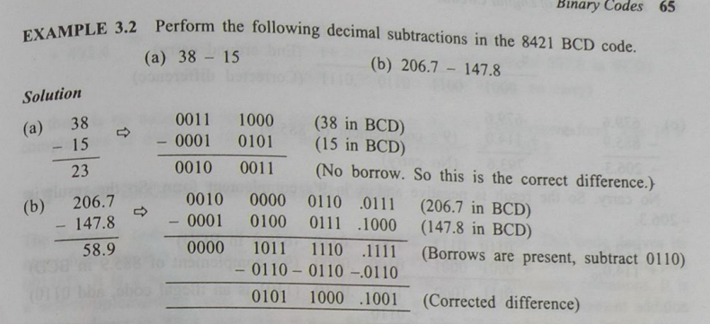
BCD Subtraction
Video Box Position

Slide 67
Non-weighted Codes
These codes are not positionally weighted. It basically means that each position of the binary number is not assigned a fixed value. Excess-3 codes and Gray codes are such non-weighted codes.
Video Box Position

Slide 68
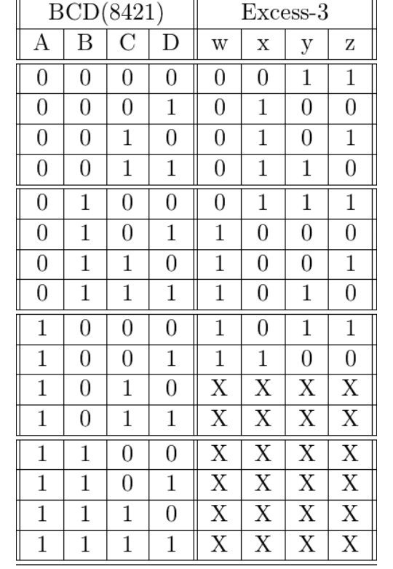
Ex-3 Code
Video Box Position

Slide 69
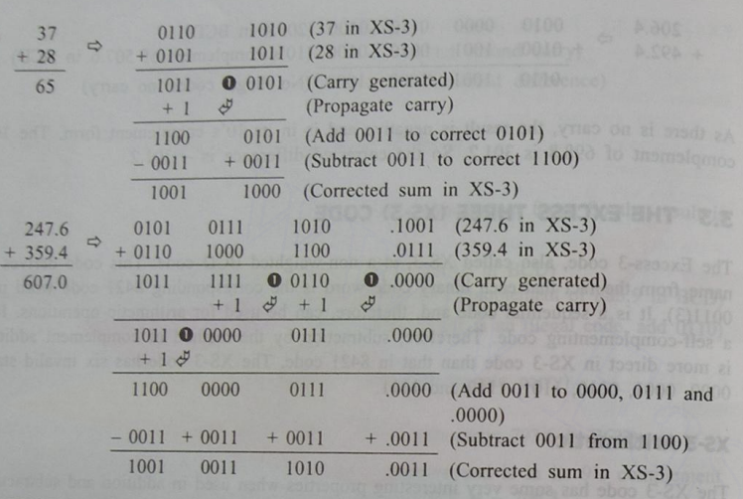
Ex-3 Addition
Video Box Position

Slide 70
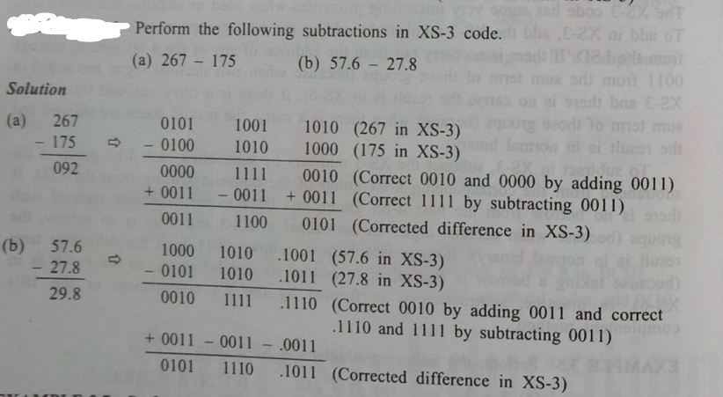
Ex-3 Subtraction
Video Box Position

Slide 71
Reflective code (Gray code)
Gray code belongs to a class of code known as minimum
change code, in which a number changes by only one
bit as it proceeds from one number to the next.
Hence this code is not useful for arithmetic operations.
This code fi nds extensive use for shaft encoders, in some types of analog-to-digital converters, etc.
Gray code is reflected code and is shown in Table
Video Box Position

Slide 72
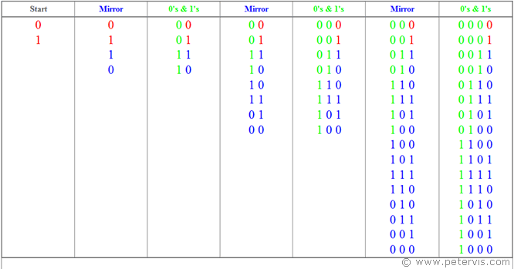
Reflective code Ex. Gray code
Video Box Position

Slide 73
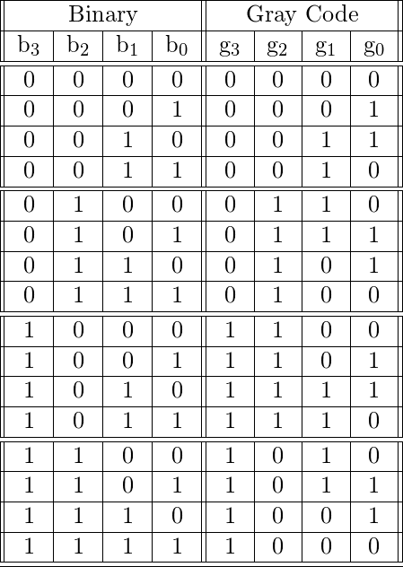
Binary to Gray code Conversion
Video Box Position

Slide 74
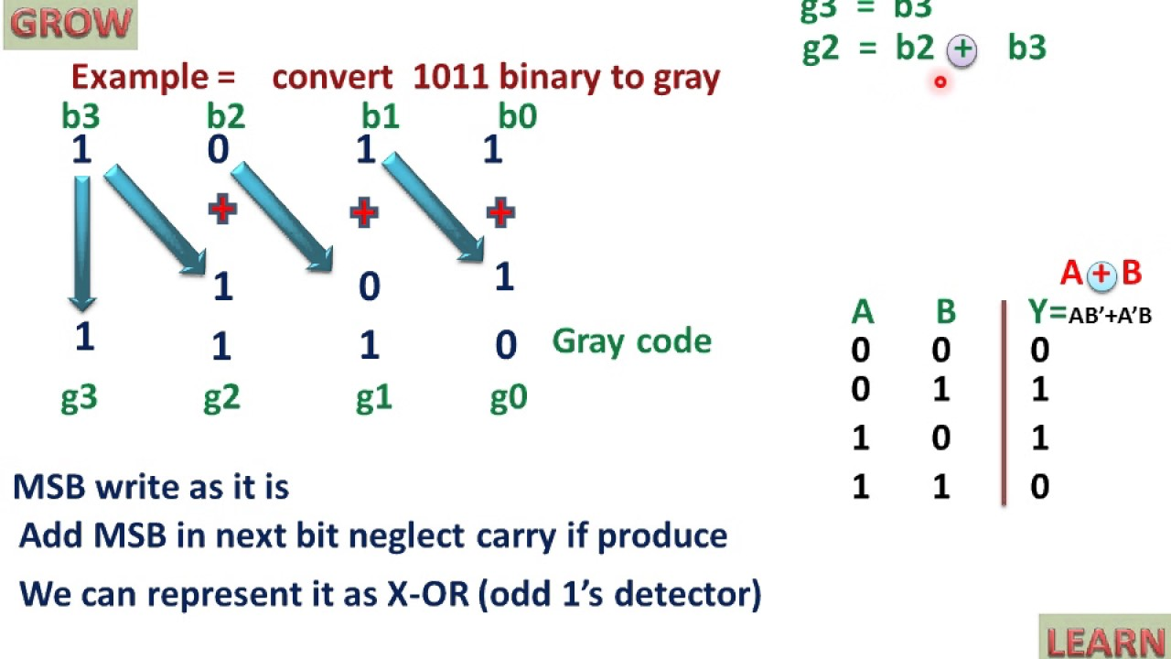
Video Box Position

Slide 75
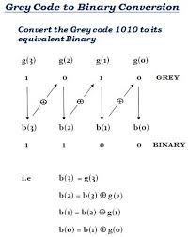
Video Box Position

Slide 76
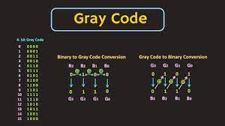
Video Box Position

Slide 77
Error-detection Codes
Parity Bit Coding Technique
Binary information may be transmitted through some
form of communication medium such as wires or
radio waves or fiber optic cables, etc.
Any external noise introduced into a physical communication medium changes bit values from 0 to 1 or vice versa.
An errordetection code can be used to detect errors during transmission. The detected error cannot be corrected, but its presence is indicated
Video Box Position

Slide 78
A parity bit is an extra bit included with a message to
make the total number of 1s either odd or even.
A message of four bits and a parity bit, P, are shown in
Table (a), P is chosen so that the sum of all 1s is odd
(including the parity bit).
In (b), P is chosen so that the sum of all 1s is even
(including the parity bit)
Video Box Position

Slide 79
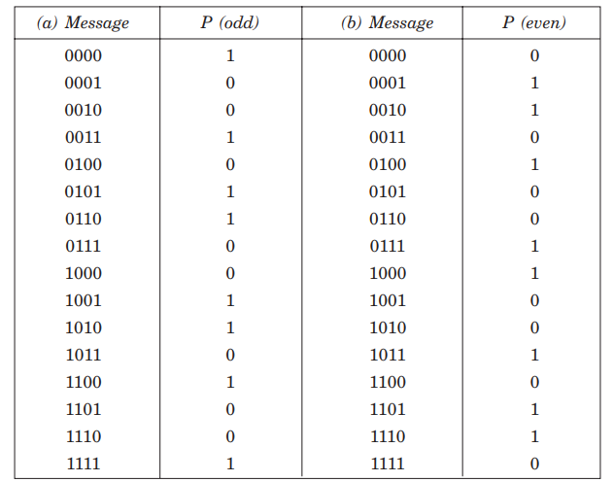
Video Box Position

Slide 80

Parity Check Error Detection Scheme
Through this scheme one extra bit is added to the four bits of information. This is one bit error detections scheme using horizontal parity

Slide 81
Parity Check Error Detection Scheme
Drawback
If Tx and Rx parity are not identical then Rx informs Tx to transmit to same message again. However, if the received message has two bit error then the parity error cannot be detected.
So, multiple errors cannot be detected. The immunity of digital system is greater than analog system, hence, the probability of error is small that is of 10 power minus 6. This particular method is effectively used and thus is used in the memory testing in computer.

Slide 82
Block Parity
When several binary words are transmitted and received at a time, then such information is regarded as a block of data, having rows and columns. For example, let us consider four eight-bit words, which are to be transmitted, forms a 4 x 8 block. Parity bits are assigned to both rows and columns.
This uses horizontal and vertical parity and can detect error as well as select bit error.
In BPED (Block Parity Error Detection) and CC (Correction Code) these messages are transmitted as a matrix of rows and columns, and to each row and column one extra bit is added so, that all the rows and columns must have either even parity or odd parity

Slide 83
Block Parity
When several binary words are transmitted and received at a time, then such information is regarded as a block of data, having rows and columns. For example, let us consider four eight-bit words, which are to be transmitted, forms a 4 x 8 block. Parity bits are assigned to both rows and columns.
Case-1
When several binary words are transmitted and received at a time, then such information is regarded as a block of data, having rows and columns.
For example, let us consider four eight-bit words, which are to be transmitted, forms a 4 x 8 block. Parity bits are assigned to both rows and columns.

Slide 84

This scheme is briefly represented in the following

Slide 85
As shown above, even parity is given to each eight-bit word and for each column. In this case, the parity bit is called block parity. The block of data is transmitted from the transmitter side.
Upon analyzing the received block of data(b), the first row has no error as the even parity is maintained. In the second row, the even parity is changed to odd parity. So there is an error in the 2nd row. Even parity is maintained in the third and fourth row and thus, there is no error.

Slide 86
To find out the error bit in the second row, let’s check the column-wise parity. If you do so, in the 2nd column, you can notice the even parity is changed to odd parity. So there is an error in the second column. In all other columns, there is no change in the even parity and hence no error in other columns.
The bit, which is at the intersection of the 2nd row and 2nd column is an error bit. In the above illustration, the error bit is marked in red color. Since the detected error is a single bit, we can change the bit 0 to 1. Thus in block parity, detection and correction of an error are possible with the parity codes.

Slide 87

Case-2
Now, take a look at the following received message.

Slide 88
In the above figure, you can observe that there is no parity bit error for each row. But for the 1st and 2nd column the even parity is changed to odd parity, which is an error.
Thus the error is seen in the 1st and 2nd column. In this case, it is possible only to detect the error. It is not possible to correct the error as there is no information revealing the row where the errors occurred.

Slide 89
Check Sums
Check Sums As we have discussed aboves the parity bit technique fails for double errors, hence we use the Check Sums method in such case. Initially any word A 10010011 is transmitted; next another word B 01110110 is transmitted.
The binary digits in the two words are added and the sum obtained is retained in the transmitter. Then any other word C is transmitted and added to the previous sum retained in the transmitter and the new sum is now retained.
In a similar manner, each word is added to the previous sum already retained; after transmitting all the words, the final sum, which is called the Check Sum, is also transmitted.
The same operation is done at the receiving end and the fi nal sum, which has been obtained here, is being checked against the transmitted Check Sum. There is no error if the two sums are equal

Slide 90

Video Box Position

Slide 91

Video Box Position

Slide 92
References
M. M. Mano, Digital Design, Prentice Hall
http://www.ied.edu.hk/has/phys/de/de-ba.htm
http://www.eelab.usyd.edu.au/digital_tutorial/
http://cwx.prenhall.com/bookbind/pubbooks/mano2/chapter5/deluxe.html
http://www.eelab.usyd.edu.au/digital_tutorial/part3/
http://wearcam.org/ece385/lectureflipflops/flipflops/
http://users.ece.gatech.edu/~leehs/ECE2030/reading/mixed-logic.pdf
Video Box Position

Slide 93
Video Box Position
THANK YOU

